Slide 1
21CSS201T COMPUTER ORGANIZATION AND ARCHITECTURE UNIT-2 Topic : Operational Concepts

Slide 2


Slide 3
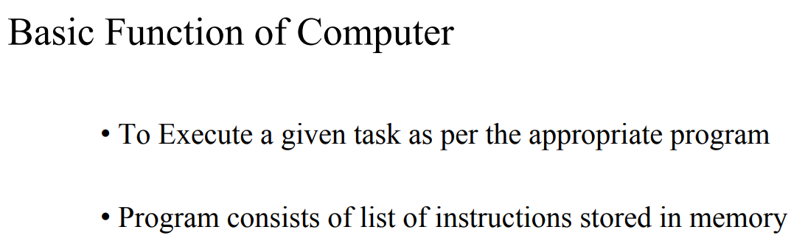

Slide 4
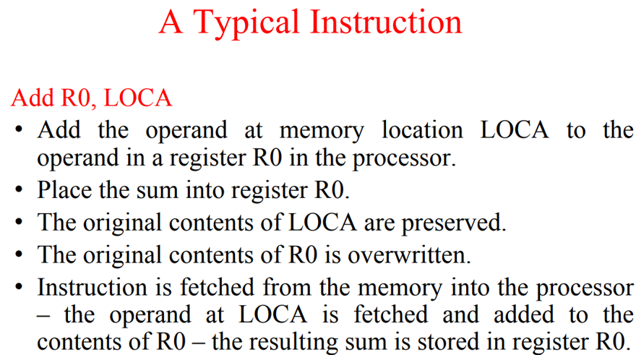

Slide 5
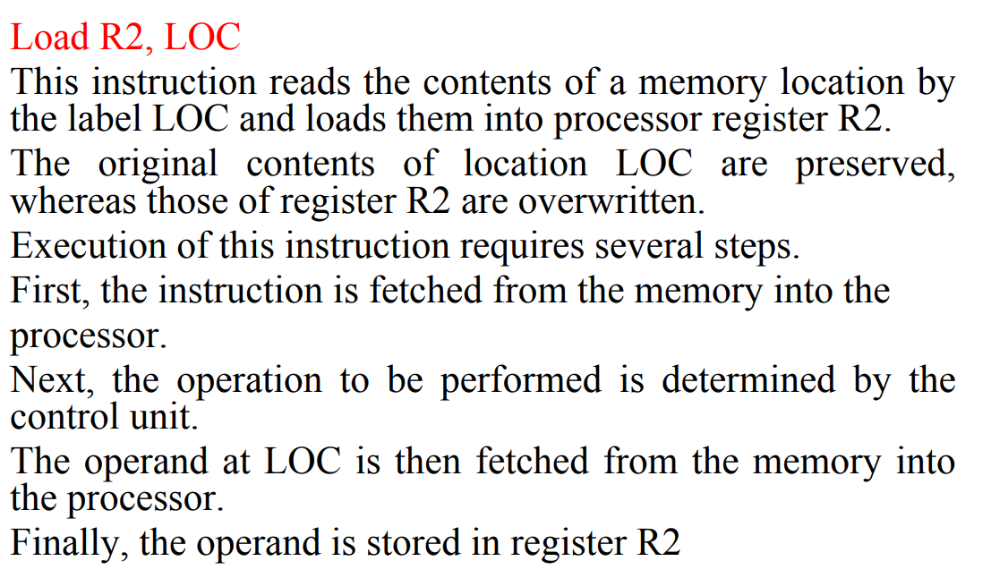

Slide 7
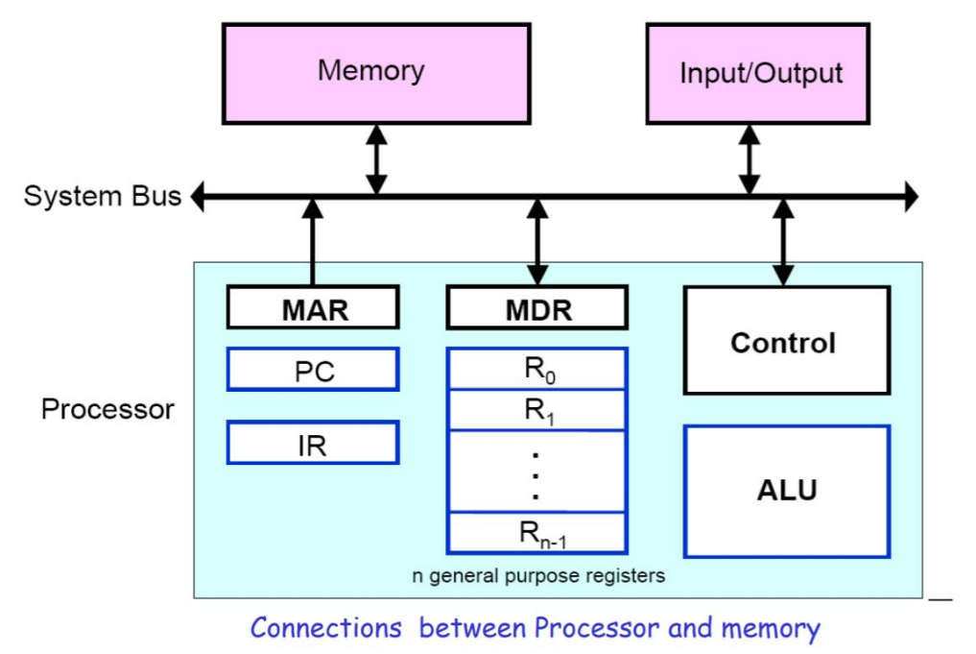

Slide 8
Registers
Registers are fast stand-alone storage locations that hold data temporarily. Multiple registers are needed to facilitate the operation of the CPU. Some of these registers are
Two registers-MAR (Memory Address Register) and MDR (Memory Data Register) : To handle the data transfer between main memory and processor. MAR-Holds addresses, MDR-Holds data
Instruction register (IR) : Hold the Instructions that is currently being executed
Program counter (PC) : Points to the next instructions that is to be fetched from memory
General-purpose Registers: are used for holding data, intermediate results of operations. They are also known as scratch-pad registers.

Slide 9
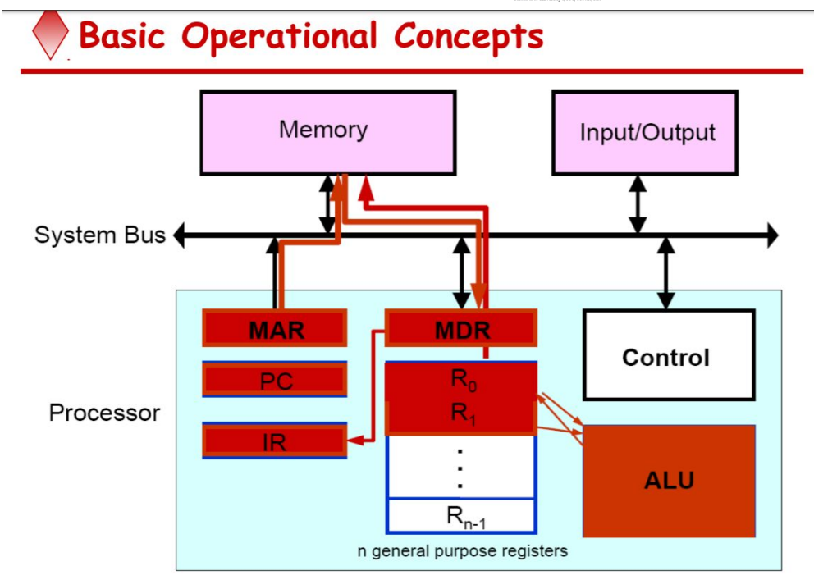

Slide 10
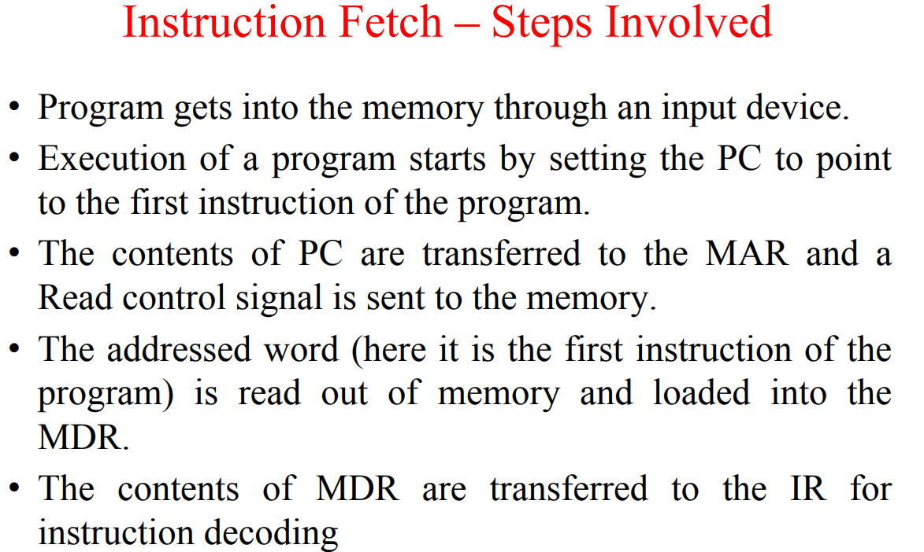

Slide 11
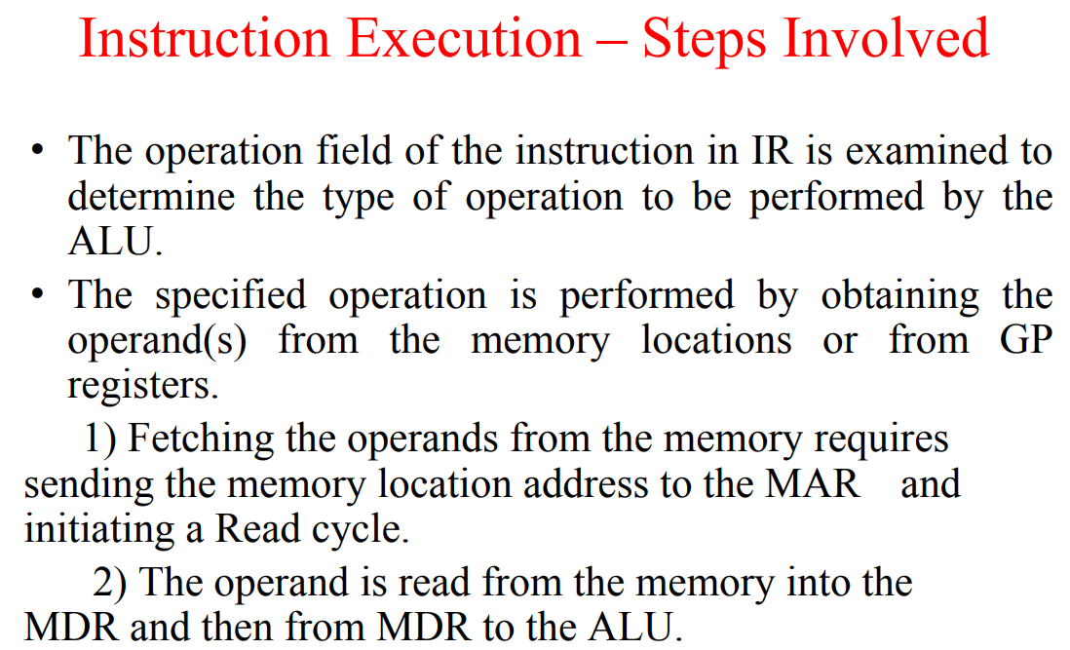

Slide 12
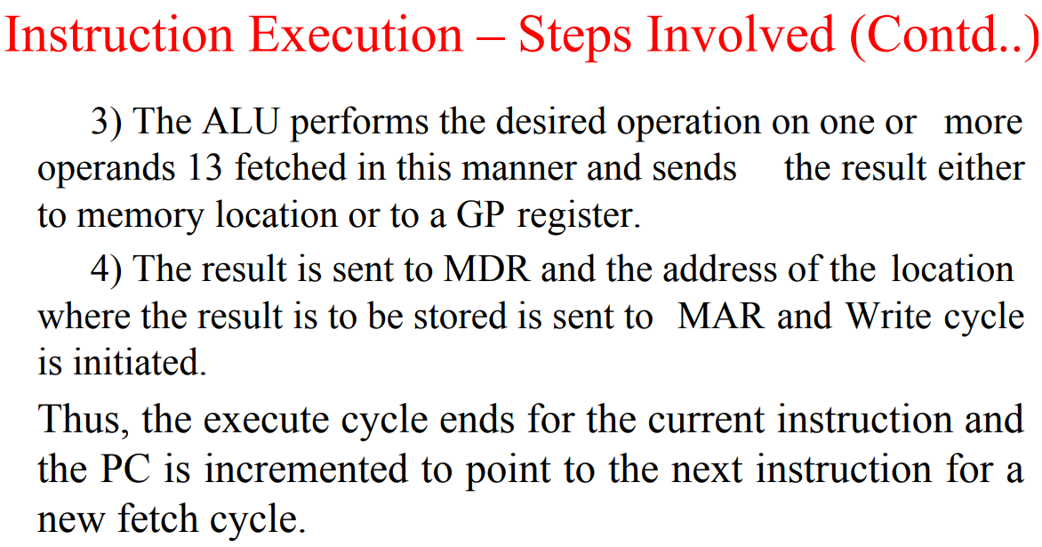

Slide 13
